Slide 1
GDC 2025 Global Delivery Center
Notes:
2025 © delaware (general)
2025 © delaware - For internal use only (for training and guidelines)
2025 © delaware - Confidential (for commercial proposals to customers)

Slide 2
Organizational model
1
Your Takeaways
2
GDC Problem Statement
3
GDC 2024 Accomplishments
4
GDC 2025 Solution Statements

Slide 3
Your takeaways
1
2
3
4
5
GDC provides delivery capacity with flexibility in scaling up or down, at competitive prices
GDC is globally managed – the role of the hosting entity
Global Solution Lead in the drivers’ seat (both for resourcing as recruitment)
GDC MT and MC: all stakeholders are involved, have a voice ànd share the responsibility to make GDC a success for all
Optimizing GDC resources is a shared responsibility. Booking approved bench time only happens after the SDM’s informal approval.
3 operating models
GDC Pool: capacity on demand
Team Extension: long-term collaboration model with resource responsibilities for selling entity
Packaged services: complete delivery of a subproject
Active improvement actions in ’25
Expectations framework
Onboarding
Feedback
Communication

Slide 4
GDC problem statement
Our GDC talent pool is disparate, inefficient and under-utilized
Our selling entity demand is fragmented, inconsistent and seeks premium skills at a senior level
Our location coverage is sufficient (though could be improved once we achieve critical mass)
Our access to talent is sufficient (though the war for talent is real) but hybrids are reluctant to scale
Our transfer costs to selling entities are high when compared to the market (in some cases higher than local consultants within the selling entities)
Our delivery quality is bumpy – partly due to selling entity expectations, and GDC offshore delivery maturity
Selling entity low adoption;
Hosting entity conflicts (2 hats, GDC as local PL)
Our discipline to apply processes and respect roles and responsibilities is inconsistent. Our GDCs operate independently of one another. We make our lives more difficult than we need to.
…there are many others….
Reminder:
Those who ignore history are doomed to repeat it

Slide 5
GDC 2024 accomplishments
5
4
Through GDC Taskforce and Management Teams Address Resource Levels, Scheduling, Recruiting, Processes, Quality and GTM Work Packages
Re-focus our Hosting Entities on Utilization, Efficiency, and Ability to Scale
Increase Target Utilization Across all Locations
Identify Leaders & Rebalance Scope of Responsibility / Objectives for Managing Director / Country Lead and Global Solution Leads (add PMO & address MWI and Data Services)
2025 Kick-off
1
3
7
Attempt to break down barriers and begin to focus our Selling Entities ON ADOPTION through Ways of Working adjustments
6
2
How to make GDCs Global – DI-Managed & Centralized
Determine Timeline and Communication Plan to meet January 2025 Kick-off

Slide 6
GDC solution statement – summary
1. Improvement initiatives
Team Extension as extra operating model (next to pool and packaged services) : better fit for Belux
Packaged services: framework (governance: propose/decide, key principles on risk, scope, volume)
Performance feedback from selling entities to GDC (tackle quality)
Expectation framework (global standards on expected skill level)
Global onboarding standardization
Alignment on collaboration/project delivery methodology

Slide 7
GDC solution statement – summary
2. GDC is Centralized and Managed Globally
Skills/Locations: Implement a global strategy on which skills to develop & scale in which location
Global Solution Leads are fully accountable for the supply and demand for their global solution. They will be assigned a stronger mandate. The hosting entity does not play a role in the supply and demand as such (for hiring, Comp&Ben, and retention: yes)
The role of the GDC Hosting Entities’ Country Leads (for Hybrids) and MDs is to run the operational processes and manage overheads, and “act as an inspiring leader for the team, and create an enthusiastic, high performing, and motivated team to deliver Delaware’s GDC vision and strategy” (see next slide)
GDC MT and MC remain as today. Although the MC’s efficiency needs to be revised.
GTM from GDC : Solution leads in driver’s seat in alignment with MT
Change: Clear accountability on Supply & Demand. Today it is ”in between” Global DC (Global Solution Leads) and Local DC (hosting entities)

Slide 8
A few examples: Global Solution Leads and Country Leads
Run operational processes for Country Lead
Ensure strict application of scheduling and time booking process
Respond to recruitment requests from the global solution lead following the designed process
Hire:
Global solution Lead decides to hire a consultant
Global solution Lead decides where to recruit and if we need freelance or employee
Country leads execute the recruitment process, decides on Comp&Ben, assess skills and level cfr expectation framework, considering cultural differences, local regulations, local Comp&Ben framework
Interview: combination (expectations from global solution lead ; local team lead)
Global support on the hiring process: TBD
Fire:
Global solution Lead decides to fire a consultant (lack of quality, lack of demand and outlook of demand)
Hosting entities leads process, considering local regulations
Quality issues
There should be an objective performance feedback process
Bring negative feed-back to the consultant : local team lead (clearly and factually documented by Global Solution lead)
Raise / bonus :
The GDC resource gets a performance review. The global solution lead (even selling entity) can express his high appreciation and need for retention. But the decision on bonus/raise lies with the hosting entity. The global solution lead cannot overrule.
Training:
On certifications: global solution lead will initiate and organize (why not aligned with any selling entity)
On more soft trainings : more opposite . Hosting entity will initiate (why not aligned within a global program)

Slide 9
GDC solution statement – summary
3. Financials: “GDC is Centralized and Managed Globally”
GDC profit is measured at global level and “distributed” amongst all GDC locations
strive for global success of the GDC
Global investment decisions
Prices are defined with a target bottom line profit of 5% (as it has been since the start of GDC), based on:
a realistic utilization target of the hosting entity (currently 75% for all GDC Locations), defined by GDC Global Management.
average overhead costs. More focus on lean overhead structure in GDC.
Hybrid Countries :
Full split between Local business and GDC. GDC business is part of the global profit center – as is today.
GDC P&L is discussed in GDC MT and MC, not in hosting entity’s MT. Globally and centrally managed. Although, the GDC results of a hosting entity remain a part of the local partnership – as is today.
Important note: Resources from a GDC location working ICO = always GDC. So, no “local” ICO assignments, which could create a shadow to GDC. Note: optimizations in case of overcapacity are still possible

Slide 10
Conclusion – what’s really new
GDC is centrally and globally managed: One GDC = one P&L
Operating models : 2 new operating models :
Team Extension (GDC resource)
Packaged Services
Ratecard : target utilization and transfer factor defined per country and approved by DI.
AMS settlement : per team across hosting entities (vs. 2024 per hosting entity)
Not new, but empowered: GDC is centrally and globally managed. The global solution leads are fully accountable for the supply and demand for their global solution

Slide 11
Governance and roles
1
GDC Management Team (MT)
2
GDC Solution Lead Role
3
GDC Management Committee (MC)
4
Scheduling Taskforce
5
Local Resource & Scheduling Responsibles

Slide 12
GDC management team
Responsibilities:
GDC Go To Market, status solution ambitions/plans
Manage GDC Supply and Demand. Actual Utilization, Scheduling, Open Resource Requests
Adoption of a Global Delivery Methodology (as defined by the Promar and global AMS GCC)
GDC Feedback and Escalations
AMS is a global business line across solutions
Global GDC Lead – Pete King
Bruno
Data, Analytics & AI
Danny
Dev & Integration SAP
Siew Fun
AMS & Infra
Mei Li
MS Bizapps
Dexter (MY)
Core ERP SAP (PTM and EWM)
Amit (IN)
Core ERP SAP (Finance, S&A and EAM)
Diana (HU)
Digital
Ataa (MA)
Core ERP SAP (OTC and PTP)
Julian (PH)
PMO Support
Global Resourcing Lead:
Gillian (BE)
Important note: AMS technical competences are member of specific AMS teams, but these teams belong to the Competence Global Solution. E.g. Integration consultants working on CC Integration AMS are part of the global solution of Danny
Resourcing Support:
Hakim (MY)
Recruitment Coordinator:
Laila (MA)

Slide 13
Role GDC solution lead
Manage Supply & Demand
Adoption global project/ AMS delivery methodology
GTM, Ambitions, Feedback & Escalations
Looking back – evaluate utilization and act. Vs. sched (reliability)
Looking forward
Scheduling (0-3mths)
Weighted pipe
Annual budget exercise
Quarterly forecast – update of the budget
GDC MT – flag key takeaways
Schedules meetings with stakeholders to achieve S&D quality (their teams, hosting entity leads, selling entity leads)
= GDC Delivery Excellence
Uses Ionbiz (RRF/planning) to capture and manage demand
Discusses and share thoughts with GDC Lead and Resourcing Lead during the GDC MT
Proactively shares (customer) feedback during GDC MT’s
Participates in smaller taskforces based on GDC’s ambitions

Slide 14
GDC management committee to enforce one GDC
Responsibility:
Responsibility:
1
P&L per Global Solution / Adoption Ratio KPI per Selling Entity // Assess, Define Actions, Follow Up on Actions
2
Look forward / trends to demand/supply 6 to 9 months outlook
3
Mid and Long Term Competence Build Up per global solution
4
Feedback on the GDC models, organization, processes, quality
Global GDC Lead – Pete King
 | Hungary | Brazil | India | Morocco | Malaysia | Philippines | China | Belgium | France | Netherlands | Germany | Singapore | US | UK
DI Engaged Partner | Bart | Patrick | Pete | Cyrille | Andy | Yoeri | Zhi Wei
Selling Entities |  |  |  |  |  |  | Edwin | Yoeri | Cyrille | Wim | Boris | Zhi Wei | Pete | Andy
Hosting Entities | Adam J. | Bruno | Amit | Ataa | Nazrin | Reina | Vincent

Slide 15
Scheduling task force
Chair
Team
Gillian Coussens (BE)
David Rittelmeyer (FR)
Sebastiaan De Roeck (BE)
Nazrin Rizal (MY)
Pete King (US)
Andy Danneels (UK)
Karsten Hulst (NL)
Sabine Liebig (DE)
Gergely Rusz (HU)
Bruno Heissler (BR)
Amit Gupta (IN)
Was created in 2022 for a specific assignment from the MC, which is completed now
Towards 2025 – extend from scheduling to supply & demand (incl. recruitment and pipeline)
TF accepted to have an advisory role on the Scheduling Process
In particular on global tools: continuous evaluation/fit gap analysis (Chicken-egg → we use what we have today + evaluate)

Slide 16
Local resource & scheduling responsibles
Selling entities
Local Resource & Scheduling responsibles
DNL | Karsten Hulst, Marc Verdonschot
DDE | Hannes Sonnen
DBR | Daniella Tatavitto
DSG | Jeremy Ee & Zhi Wei (SAP), Desmond (EIM), Bansal Nikhil (Microsoft)
DUK | Nhavie Mckenzie-Healy (Liv George - Operation Manager)
DNA | Liliany Young, Ashley Bryant
DBE | Sara Van der Straeten, Sebastiaan De Roeck (FINOPS)
DFR | David Rittelmeyer, Aaron Gaguesh
DHU | Beata Borsoz
DCN | Vivian Gu, Tracy Wang
DPH | Reina Chua
DMY | Raja Azizul, Tivashini Pushparajah, Sheila Ann Doss
DMA | Amine Khalyl
DIN | Gowri Suresh

Slide 17
Organizational structure
1
GDC Solutions – Our menu card
2
FTE’s per location
3
Skillsets per location

Slide 18
Mei Li Khoo
Dynamics 365 (CE and F&O)
Power Platform (PowerApps, PowerAutomate, PowerPages and PowerVirtualAgents)
MS integration
Mobile, Web, IOT (Angular, React, .Net)
Danny Sprangers
SAP development (ABAP, fiori, java, abai in the cloud, RAP, CDS views, forms, …)
SAP integration (PI/PO, CPI)
MS BizApps
Dev & Integration SAP
Dexter Ng
SAP Operations: Enterprise Warehouse Management (EWM), Plan To Manufacture (PTM), Quality Management (QM)
Data Services: Master Data Management (MDM), Data Migration, Data Quality Management, SNP Crystalbridge
Presales: SAP
Core ERP SAP (PTM and EWM)
Bruno Heissler
SAP Data & Analytics (HANA, SAC – BI/P, DWC, BPC, BW, etc.)
Microsoft Data & Analytics (Power Bi, Azure Databricks, Azure Data Factory, Azure Machine Learning, Azure Synapse Analytics, Azure, Machine Learning, etc.)
Data, Analytics & AI
Diana Bartfai
Digital (Sitecore, Kentico, UiPath, Virto Commerce, etc.)
Salesforce
Digital
Siew Fun Wai
AMS Functional solution, including Operation Delivery Management(ODM) and Service Desk Function.
SuccessFactors - Employee Central, EC Payroll, Recruitment & Onboarding, Performance & Goal, Succession & Development, Learning Management, Compensation Management
SAP Basis (all SAP related implementation/systems : RISE, SAP on azure, SAP on premise, other SAP cloud systems)
MS Azure Devops/Infra (all azure infra related setups)
AMS & Infra
Amit Gupta
Core Finance : GL, AR, AP, Asset Accounting, Bank Account Management (BAM), Profit centre Accounting, Cost Center Accounting
Finance+ : Central Finance, Vendor Invoice Management (OpenText), Treasury & Risk Management, Fund Management, Tax Management, Intercompany Recons (ICR), Financial Closing cockpit, Budgeting & Forecasting (SAC), Compliances
Controlling: Profitability Analysis, Product costing
SAP Operations: Enterprise Asset Management (EAM)
Security, Authorization and Governance, Risk, and Compliance (GRC)
Core ERP SAP (Finance, S&A and EAM)
Julian Suarez
PM Assistance, Project QA Processes, PM-tool support (devops, dlw experience monitor, PowerBI,…), PROMAR templates, support GCC’s.
PMO: Project Management, PMO Support, SPOC, Cutover Management, Testing Management
PMO Support
Ataa Erroussafi
SAP Sales modules: Order To Cash (OTC), Sales Industry Solutions for Utilities (ISU) , Customer service (CS)
SAP Buying modules: Procure To Pay (PTP), SAP Ariba Buying (ARIBA), Master Data Management (MDM)
SAP CX (SAP Sales, SAP Services, etc.)
Core ERP SAP (OTC and PTP)

Slide 19
GDC coverage – global profit centers
Roll-up possible per Ecosystem and per solution
Global PC's = combination of ecosystem and solution |  |  |  | Agnostic
Business Consulting | - | -
Digital | (CX)
Data, Analytics and AI
Core ERP
Development & Integration
HR
AMS
Infrastructure
Information Mgt
Global PC | GDC Solution | Global solution owner
Business Consulting Agnostic | PMO Support | Julian
Digital Agnostic | Digital | Bruno
Development & Integration Agnostic | Development & Integration SAP | Danny
Digital MS | Digital | Bruno
Data, Analytics and AI MS | Data, Analytics & AI | Bruno
Core ERP MS | MS BizApps | Jonas
Development & Integration MS | Development & Integration SAP | Danny
AMS MS | AMS & Infra | Siew Fun
Infrastructure MS | Development & Integration SAP | Danny
Digital Salesforce | Digital | Bruno
Digital SAP | Digital | Bruno
Data, Analytics and AI SAP | Data, Analytics & AI | Bruno
Core ERP SAP | Core ERP SAP (OTC & PTP) Core ERP SAP (PTM & EWM) Core ERP SAP (Finance, S&A and EAM) Presales | Ataa Dexter Amit Juliana
Development & Integration SAP | Development & Integration SAP | Danny
AMS SAP | AMS & Infra | Siew Fun
Infrastructure SAP | AMS & Infra | Siew Fun
Notes:
SAP
Core erp
Dev and int
Ams
Infr

Slide 20
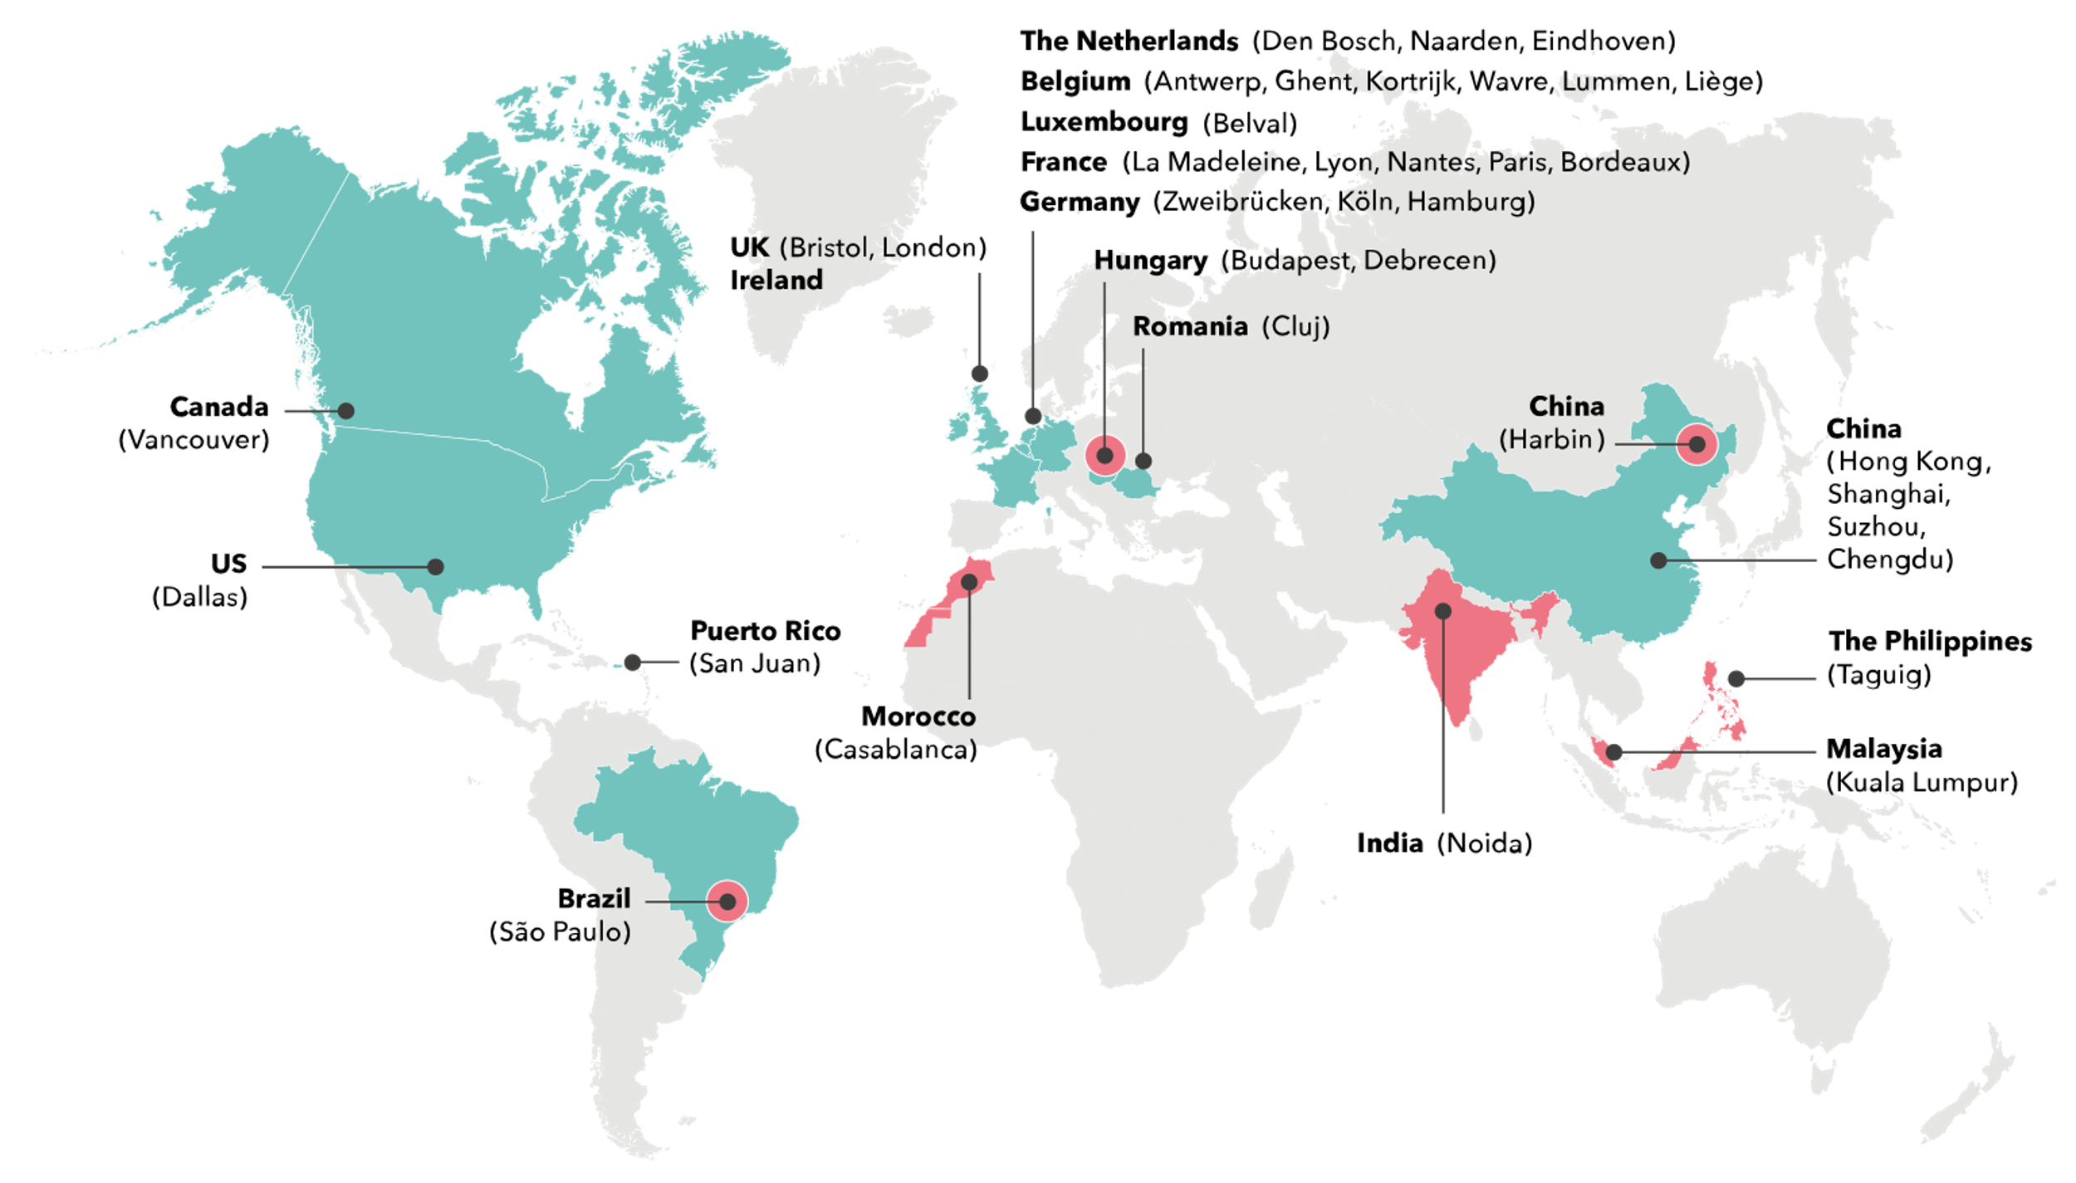
FTEs in each GDC location
Last update: 07/11/24
Country | FTEs
Brazil | 92
China (Harbin) | 41
Hungary | 18
India | 111
Morocco | 57
Malaysia | 201
The Philippines | 87
18
41
111
57
87
92
Global Delivery Centre
201
Scheduling and Availability Dashboard
Singapore
(Singapore)

Slide 21
Financial model
1
The Essentials of our Models
2
3 GDC Offering Models
3
Levels & ratecard

Slide 22
Essentials of the financial model
One Global Rate Card expressing the Transfer Price, per entity, per level. Transfer Price = Cost Price * Transfer Factor.
One GDC = one P&L
Selling Entity
Driver to work with GDC: flexible project resources at competitive prices
Adoption Ratio Target as Global KPI for each Selling Entity = GDC man days/Total man days
GDC models Pool, extended team and package services
Key element is predictability and operational efficiency (scheduling/demand/….). We want to realize this by empowering people, not by a financial model

Slide 23
Adoption ratio target and budget
Country | Actual Adoption 2023 (*) | YTD Actual Adoption 2024 (Oct) | Target Adoption Ratio 2024 | Target Adoption Ratio 2025 | Budget Adoption Ratio 2025
UK | 31,9% | 31.5% | 30% | TBC | TBC
Singapore | 28,5% | 38.2% | 25% | TBC | TBC
US | 16,7% | 23.6% | 30% | TBC | TBC
Germany | 8,4% | 4,2% | 15% | TBC | TBC
Belux | 7,0% | 8,3% | 11% | TBC | TBC
China | 14,7% | 12.3% | 10% | TBC | TBC
France | 11,4% | 13.4% | 15% | TBC | TBC
Netherlands | 4,6% | 5.5% | 10% | TBC | TBC
Grand total | 12,4% | 14,5%
*2023: including the Indian resources working for US & internal projects only for DI

Slide 24
Adoption ratio target and budget: CORE ERP not yet in since the
Country | Actual Adoption 2023 | YTD Actual Adoption 2024 (sept) | Target Adoption Ratio 2025 | Budget Adoption Ratio 2025 | Actual Adoption 2023
UK | TBC | TBC | TBC | TBC | TBC
Singapore | TBC | TBC | TBC | TBC | TBC
US | TBC | TBC | TBC | TBC | TBC
Germany | TBC | TBC | TBC | TBC | TBC
Belux | TBC | TBC | TBC | TBC | TBC
China | TBC | TBC | TBC | TBC | TBC
France | TBC | TBC | TBC | TBC | TBC
Netherlands | TBC | TBC | TBC | TBC | TBC
Grand total | TBC | TBC | TBC | TBC | TBC
(2023: including the Indian resources working for US & internal projects only for DI)

Slide 25
Adoption ratio target and budget: DEV & Int (hvl procent van onze capaciteit?)
Country | Actual Adoption 2023 | YTD Actual Adoption 2024 (sept) | Target Adoption Ratio 2024 | Target Adoption Ratio 2025 | Budget Adoption Ratio 2025
UK | 31,9% | 31,6% | TBC | TBC | TBC
Singapore | 28,5% | 37,5% | TBC | TBC | TBC
US | 16,7% | 23,2% | TBC | TBC | TBC
Germany | 8,4% | 4,3% | TBC | TBC | TBC
Belux | 7,0% | 8,3% | TBC | TBC | TBC
China | 14,7% | 12,2% | TBC | TBC | TBC
France | 11,4% | 13,2% | TBC | TBC | TBC
Netherlands | 4,6% | 4,9% | TBC | TBC | TBC
Grand total | 12,4% | 14,5% | TBC | TBC | TBC
(2023: including the Indian resources working for US & internal projects only for DI)

Slide 26
3 GDC offering models - essence
GDC Pool (default)
Team Extension
Packaged Services
GDC capacity on demand
Selling entities requesting resources for local projects
PM is responsible to steer both local and GDC resource and is backed up by a GDC SPOC
Selling entity’s requesting named resource as extension of its local team
A selling entity is fully responsible for a GDC resource:
Scheduling & utilization (incl. financial risk)
Recruitment involvement
Termination compensation (if needed)
Training (incl. related costs)
Hosting entity is fully responsible for:
Compensation and benefits
Performance process (considering the performance review from the SE)
The contract period is indefinite. In case a selling entity wants to lay off a person, they need to bear the financial consequences. However, GDC can check to reassign the resource to the pool or another entity’s extended GDC team.
The hosting entity is fully in charge of delivery of a subproject
SOW, defining scope and budget
Small SOW volume, specific offerings
A GDC PM on this subproject is also booking time
No commercial risk on GDC’s side.
Proactive follow-up by GDC on actuals vs. budget (PMO)

Slide 27
GDC offering models - practicals
Model 1
Model 2
Model 3
GDC Pool (default)
Team Extension
Packaged Services
Supply & Demand | Assignment-based model via planning | GDC resource remains part of GDC team from an HR perspective GDC resource is part of a local team from an operational perspective (SF extended team) | Full subproject assignment Selling entity sends SOW requests to GDC. GDC responds with budget estimate in mandays, leading to an agreement between both entities.
Planning | RRF in Ionbiz leading to Ionbiz planning Use of DEDI codes remains possible, but the GDC resource won’t be linked to a local team as with the ‘Team Extension’ model | Extended team lead manages the Ionbiz scheduling | GDC PM schedules the GDC resources and himself on the subproject
Delivery | Under the leadership of the PM. They can give feedback via feedback mechanism | Under the leadership of the Extended Teamlead. | PMO ensures correct delivery and follows up on actuals vs. budget. Conversations with customers remain with selling entity. They can give feedback via feedback mechanism
Pricing | Default ratecard (based on utilization and overheads of the hosting entities) | Default ratecard (based on utilization and overheads of the hosting entities) Contract = agreed cost* of the employee | Default ratecard (based on utilization and overheads of the hosting entities)
Billing | Automatic billing for project transactions Settlements: approved bench Settlements: approved training ICO | Automatic billing for project transactions Settlement: cfr. contract | Automatic billing for project transactions Only performed hours are billed. Over or underrun is possible, but proactively discussed with selling entity and GDC PMO. No approved bench time bookings
* Agreed Cost = Fully loaded salary + overhead + 5%
Notes:
Indicating local team’s extension : to indicate if we need to add an extra field in SF or IOnBiz : investigation ongoing
People of team extensions are not in separate teams.

Slide 28
Request your team Extension
I’m considering a new extended team member. How to get this done?
Contact GDC Lead – We will search for the fitting profile internally/externally
Once the profile has been found, the selling entity will need to sign a formal indefinite contract for this team extension.
GDC Lead logs ICC ticket on SF queue – 1st line will update the ‘extended team’ field in SF for the respective employee that will feed our master data.
Who should take the lead in team extension proposals or decisions?
It’s up to the selling entity to decide where an extended resource should be considered to obtain full operational responsibilities. The GDC Lead can always identify cases where makes sense to propose the extended team model instead of the current pool model towards the requester.
How to follow up on my extended team?
The extended team measure will soon become available in our reporting models. For Ionbiz planning purposes, you can create a custom filter with selected resources.

Slide 29
Example: Financial impact of Team Extension model
Note :
Agreed monthly costs is based on the individual salary of the person + company overheads + 5%.
Salaries might fluctuate if new government requirements or rules are implemented in the specific country
Salaries may fluctuate over the years based on agreed salary increments
Additional recharge is possible when a bonus is awarded.

Slide 30
Operating model : level definition
Level | Experience
Analyst | 0-3
Consultant | 3-8
Sr Consultant | +8
Lead Expert | +12
Manager | +15
Sr. Manager | N/A
Director | N/A
New level definitions in terms of year experience equally across GDC
No Junior Consultant in GDC anymore
Building an expectations framework is one of the GDC 2025 ambitions

Slide 31
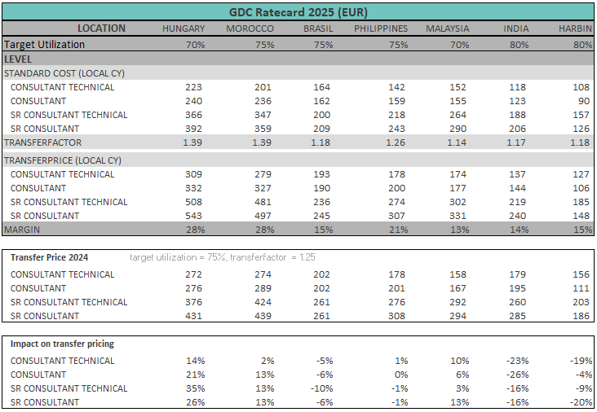
Operating model : Ratecard 2025
Target utilization defined per entity per entity (between 70% and 85%)
Transfer factor based on overheads PY with markup to lead to 5% net result BT. Comparison with budget overheads will be made
Budget overheads will be approved by DI MC
Considered as overhead GDC : all entity overheads, except marketing, IT (not laptops) and bad dept provisions.
In this example (based on overheads PY and utilization PY):
Hungary & Morocco higher transfer factor (= high overheads) > higher transfer pricing
Brazil & Philippines lower transfer factor (=lower overheads) > lower transfer pricing
India & China Offshore higher target utilization(75% > 80%) > lower transfer pricing
Malaysia stays the same due to lower transfer factor (low overhead) and lower target utilization (75% > 70%)
Ratecard : see teams intercompany collaborations
Notes:
Note : GDC specific overheads are booked against GDC profit centers, non-GDC specific overheads are booked against non-GDC profit centers. Only the costs booked against real overhead cost centers are divided pro-rated the FTE’s.

Slide 32
Time: scheduling and timesheets
1
Process – Scheduling and Timesheets
+ some practical examples
2
GDC Settlements per model

Slide 33
Process – scheduling and timesheets
Scheduling
on Customer project
on Dedicated project
Note: enter the name of the selling entity responsible in the “subject” field
Note: code AMS/IMS + code “billable work” for developers is only for local scheduling (not GDC)
Timesheets
Billable time - On customer project
GDC fee-earners, presales team, and Sales Support Team book presales on internal projects to assist in presales activities for selling entities. If presales are conducted to promote GDC, the time allocated for presales won’t be charged (=booking on CRM/HS Presales code).
Non billable time – (both for scheduled customer project and dedicated projects)
Approved Bench Time: ADMN019-xx Dxx Approved bench time
Training requested by ICO: ADMN018-09 Training requested by ICO
Non billable activities can never be booked on local ADMN codes by GDC!*
Roll off period of 1 month = Change scheduling. If too late, approved bench time as described above.
Notes:
Scheduling code AMS/IMS : only for local scheduling (not GDC). Why ? We should make 1 code per country. One could say “why not?”. Well, we could do this, but we believe it’s more simpler to have Customer project OR DEDI. And in DEDI you can filter on AMS teams (departments in IB). What about SAC? Subject is not in SAC so best practice to do operational follow up in IB.
Billable work (developers): idem

Slide 34
Customer code
Dedicated code
Whenever there’s a specific customer assignment
Resource’s reserved formally for a certain selling entity, but no clear specific assignment
Fill in the requester’s name in the ‘subject field’
Possibly change planning to the customer code from the moment there’s some clarity on the assignment.
Formal settlement reference in Ionbiz
Formal settlement reference in Ionbiz
Included in scheduled utilization
Included in scheduled utilization
Non-utilized time booked on ‘approved bench time’ code Shared responsibility
Non-utilized time booked on ‘approved bench time’ code Shared responsibility

Slide 35
Scheduling and timesheets: specific for GDC pool
Golden rule: For time & billing, GDC applies same principles as a selling entity (should) towards customers. No overhead-time will be charged
We want to stimulate the dialogue, the conversation. This code just replaces settlement “calculations”, based on same Act vs Sched deviation
We want to facilitate capacity reservation of resources, not on 1 specific project (e.g. project is not sold yet, AMS)
In detail: How do I operate in dlw GDC.docx
Manual invoices for approved bench time + training requested by ICO: will be invoiced on a monthly basis. The invoice will be sent to the selling entity (not to several solutions)
Notes:
No different ratecard within HU, BR, PH for GDC vs non-GDC
→ from 80% to 70% = price increase of 14,3% → from 80% to 75% = price increase of 6,7%

Slide 36
GDC settlements
Shared responsibility: avoiding settlements is a shared responsibility (see next slides)
How does the rebilling work? Non- AMS: resource level ; AMS: on team level across entities
Scheduled for 60% and working for 60%? No extra billing.
80
60
Scheduled for 75% and working for 60%? Extra billing will be done based on the approved bench bookings.
80
60
Booked on customer code
Booked on approved bench
Scheduled for 90% and working for 60%? Extra billing will be done to come to max. 80% util. based on the approved bench booking.
80
60
Booked on customer code
Booked on approved bench

Slide 37
Example – customer project
4. If PM really has no work (before the end of the roll off period), the consultant can book time on “approved bench time”. This will be billed to Selling entity
2. Working as scheduled is a shared responsibility
1. Selling entity requests resources via IonBiz
3. Roll off period of 1 month: approved bench time
Roll off period: we ask 1month roll off notification
Approved bench time:
People book all approved bench time (after consulting PM/SPOC)
Recharged to selling entity = min(scheduled – actual ; 80%standard hours – utilized hours – absence; approved bench)
Notes:
SDR input:
Step 3 and step 4: who takes up follow up of actuals vs bench for GDC resources? Selling entity coordinator? Local entity coordinator? Project manager? Consultant? -> for me and/and/and, but based on my experience this is not reality at this moment. What with team extensions rather as project focussed consultants?
Invoicing: GDC Bench time (so time that was requested but is not chargeable on project should be avoidable at any cost but at this moment is registered or on a local approved time code that after a quarter (?) is recharged to the selling entity but in other cases booked on internal project code of the selling entity (most often a solution cost center). Need to align.
Roll off period is a very good going forward but should be well communicated as some of our PMs cant even force this at our end customer ;)

Slide 38
Example – dedicated project (same as customer project approach)
5. If PM really has no work before the end of the roll off period, the consultant can book time on “approved bench time”. This will be billed to Selling entity
1. Selling entity requests resources via IonBiz
4. Working as scheduled is a shared responsibility
6. Roll off period of 1mth: project work or approved bench time
2. Selling entity might want to follow specifically the dedicated resources: are they booked on a project?
Roll off period: we ask 1month roll off notification
Approved bench time:
People book all approved bench time (after consulting PM/SPOC)
Recharged to selling entity = min(scheduled – actual ; 80%standard hours – utilized hours – absence; approved bench)

Slide 39
How to register late roll off for pool ?
Roll off in time
respecting the notice period of 1 month: just adjust the scheduling for today+1mth. The team lead will approve. Just like any other scheduling
Late roll off
you want to roll off a person now, but don’t have work during the coming month = notice period.
The GDC resource will be able to charge approved bench time. Unless of course there is other work (anywhere)
GDC mgt will try to find work for the resource --> need to make this visible. How? Scheduled under Project DEDI<entity>, Task <late roll off> . Planning status is in request or approved. See snip
Consequence in reporting
The GDC resource is shown as scheduled (not available)-> Clear for the GDC resource they can charge approved bench time ​
This specific Task “Late roll off”is very explicit in IonBizz -> facilitates the GDC management to do their upmost to find other work so that the GDC resource does not need to charge approved bench time.​
Important note
Don’t delete any scheduling for the coming month.

Slide 40
Example – late roll off
Gillian (GDC resource) got fulltime reserved for a Bekaert project for 3 months, from the beginning of June until the end of August for BELUX.

Slide 41
Example – late roll off
On July 10th, the Belgian PM who requested Gillian decides that he’ll only need 1 week any more of Gillian’s time. This means that Gillian will become available again as of July 17th.
As the roll off period is 1 month, that means that from July 17th until August 10th Gillian will book his time in the TS app on the ‘Approved Bench time’ code for BELUX.
Keeping the roll off period of one month in mind, that means we can simply delete the planning as of August 10th.

Slide 42
A few truths and untruths
FAQ

Slide 43
A few truths & untruths
Finance
When I schedule a GDC resource (dedicated or on a project): am I financially committed for the whole duration of the scheduling? (= pool model)
No
Roll off is possible = adjust scheduling:
Selling entity needs to adjust scheduling 1 month upfront
If this was not done 1 month upfront, GDC still tries to reschedule the resource.
If successful -> GDC resource is utilized -> no extra billing to selling entity
If not successful -> GDC resource can book an approved bench time -> extra billing to selling entity
Approved bench time = financial settlement:
Scheduling is a shared responsibility, starting at GDC side!
If Scheduled but really no work ànd late roll off : approved bench time
Scheduled Project Break (e.g. Christmas) or Delay:
same rules as roll off
Notes:
No different ratecard within HU, BR, PH for GDC vs non-GDC
→ from 80% to 70% = price increase of 14,3% → from 80% to 75% = price increase of 6,7%

Slide 44
A few truths & untruths
Finance
1
2
3
4
Does selling entity pay extra for 24/5 (shift/local public holiday)?
No
Does selling entity pay extra for week-end on call?
Yes, allowance + intervention surplus @ 175% of the intercompany rate
Does selling entity pay for time of SPOC/ODM (AMS)?
yes, at normal IC rates
Do we have 2 ratecards – ‘Pool’ and ‘Team extension’?
No – there is only one ratecard for both models, although the extended team model works on a fixed agreed cost per month (cf. contract).
5
6
7
8
If I schedule a resource as ‘dedicated’, is this always at 100%?
No – the pool model is flexible
Settlements?
See the ‘Scheduling & Settlements’ section in this slidedeck
Is scheduling on dedicated code = scheduled utilization?
Yes, if status = in request or approved (just like any other project code)
Are settlements equally calculated between AMS & non-AMS teams?
No, non-AMS settlements are calculated on resource level and AMS settlements are calculated per team across hosting entities.

Slide 45
A few truths & untruths
Operations
1
2
3
4
5
Who’s responsibility is it to update scheduling to avoid settlements?
This is a shared responsibility. GDC will try to proactively spot overscheduling will the selling entity should monitor their reserved capacity (scheduling) sporadically.
List of extended resources?
We’re currently working on filter possibilities in reporting. In Ionbiz you can create a custom filter on name level.
Is team extension cheaper?
Not specifically – depends on how efficient you use your resource’s capacity.
What if I have team extension and after 2year the demand drops?
The GDC will look for a solution, but in case no solution is found the financial commitment stays with the Selling entity.
I am a GDC resource and I am scheduled on ‘Dedicated FR10’, who do I contact ?
The name mentioned in the scheduling (subject field) OR the local Resource& Scheduling Responsible (see list in this ppt)
Notes:
No different ratecard within HU, BR, PH for GDC vs non-GDC
→ from 80% to 70% = price increase of 14,3% → from 80% to 75% = price increase of 6,7%

Slide 46
A few truths & untruths
Other
1
2
3
Do we have a global GDC travel policy?
No, travel policies are part of local HR policies.
Travel expenses:
paid by selling entity if the travel is on request of the selling entity (expenses: only hotel and travel, no per diem/dinner/lunch)
Certification training:
if requested by the selling entity extra code under Training “Training requested by ICO”. Billing to selling entity (manual, similar as approved bench time). Certification on the GDC’s initiative is booked on the local training code and should be included in the solution’s budget.
4
5
6
Onboarding of new resource = Local HR:
no recharge (overhead support)
SPOC for dedicated resources:
this is close to similar to team lead role, so no recharge for this role (overhead support)
Queue hero:
no recharge (overhead support)
Notes:
No different ratecard within HU, BR, PH for GDC vs non-GDC
→ from 80% to 70% = price increase of 14,3% → from 80% to 75% = price increase of 6,7%

Slide 47
Self learning section

Slide 48
Data transparency: tools and processes
1
Scheduling: Ionbiz
2
Recruitment: Devops Recruitment
Reporting: SAC
3
+ examples
4
Sales Pipeline: MS CRM or Hubspot
For selling entities

Slide 49
The importance of data transparency
1
2
3
All entities have 1 entry point to request resources (handled by local schedulers or GDC solution leads)
All GDC entities have 1 entry point to register recruitment launches (internal/freelance) On global level – WIP – scattered recruitment tooling landscape
Full data transparency as an objective:
As a Global GDC Solution Lead/MD/Local Solution Lead/PM I have a 100% clear view on capacity and capacity need, ànd on P&L
As a resource I know my own scheduling and I can act on it
As a selling entity (MD, PM, Solution lead) I can consult the adoption ratio and benchmark with target or other entities

Slide 50
Resource request and scheduling : global processes and tools Open recruitment demand : global processes and tools
Global scheduling coordinator:
Local PM/Scheduler: GDC resource request
GDC Solution leads
assign resources
If to be hired (internal/external):
Team Lead registers Open Demand
Recruit and assign resource
global overview of scheduled% , of open demand
Sometimes via global scheduling coordinator
Escalations
ensure strict application of process and tools
Local PM/Scheduler: local resource request
Local Schedulers assign resources
If to be hired (internal/external ):
Team Lead registers Open Demand
Recruit and assign resource
IonBiz
IonBiz Scheduled resources
Devops Open Demand= to recruit
IonBiz Status “escalation”
IonBiz Scheduled resources
Note: resource Request: via RFF or direct scheduling of a resource (both to be approved by team lead)
Notes:
FTE = FTE on payroll (all levels)
Turnover 2021: 403 M in international DB – ok, in line with consolidation
CH7 is after dFund reserve

Slide 51
Ionbiz – RRF
Scheduling

Slide 52
Resource request form flowchart
Ionbiz
Maintenance
Needs GDC Resources on project
Fill in and submit GDC RRF
No fit with proposal?
Requester proactively validates resource assignments
Proactive (+1mth) planning edits to avoid unnecessary settlements
Requesterr / Local PM
Triggers email
Reviews GDC RRF and aligns with local TL
‘selected resource’ field gets filled in
Ionbiz planning gets pushed
GDC Lead
Local GDC TL
Finds the right resource together with the SL
Proactive (+1mth) planning edits to avoid unnecessary settlements
Identify whether GDC resources can be staffed on your project
Support the entity’s GDC adoption ratios
Fill in the GDC RRF with all the necessary information
Submit the form so it gets sent to the right GDC Lead
GDC Lead will align with the right local TL to provide the right GDC resource for your request.
After alignment with the local TL, the GDC Lead fills in the name in the ‘selected resource’ field
Simultaneously, Ionbiz planning gets pushed to the planning overview
Avoiding unnecessary settlements is a shared responsibility
Both the local TL and requester need to monitor the approved bench bookings or the consultant’s feedback
DESCRIPTION
Note: resource Request: via RFF or direct scheduling of a resource (both to be approved by team lead)

Slide 53
RRF SLA’s
D+0 RRF Creation
Requester submits RRF
Project start – 5WKS
Validate RRF assignments
Backfill remaining dummies with real names
D+3
GDC (Lead) Commits on submitted RRF
Selected resource (low probability? -> tentative)
Dummy resource
Project Start
Resource is planned and starts booking efforts
Resourcing support: Nurhakim Omar
Redirect people towards Inside/Hakim if they don’t know how to log an RRF.

Slide 54
Recruitment
Devops

Slide 55
GDC recruitment – tooling landscape
Entity
Tool
dBELUX | SF Recruitment
dFR | Teamtailor
dNL | SF Recruitment
dUK | SF Recruitment
dUS | Trello
dCN | Spreadsheet
dSG | Spreadsheet
dBR | Selecty
dDE | SF Recruitment
dMY | Devops
dPH | Devops ➔ considering other tool
dHU | SF Recruitment
dIN | Keka
dMA | Devops, Teamtailor
The current recruitment tooling landscape is very fragmented
SF Recruitment: 5
Devops: 3
Other: 5
GDC Process:
We currently use Devops to initiate GDC recruitment requests. The hiring GDC locations can use their local tool to recruit as long as they update the Devops as well
One of the Global Resourcing Lead’s ambitions is to move towards one global recruitment tool starting in 2025.
Notes:
Delaware Belgium was first one – they paved the way and set up the standard.
We don’t use the SF Candidate profile yet, which is blockin us of using all the SF Recruitment functionalities (e.g. making them an online offer)

Slide 56
Recruitment Coordinator Recruitment Coordinator
Objective: Support GDC SL’s in their recruitment needs and be the link between them and the recruiting entities.
Identify and logs recruitment requests upon SL’s approval
(Short) recurring meetings with the GDC SL’s
Picks up high prio (adhoc) recruitment requests and coordination
Proactively build up recruitment pipe in line with solution’s ambitions (+ with GDC SL’s approval)
Follows up and has the latest status on the GDC hiring process in the hosting entities.
Reporting
Guarantees up to date results
Improves and expands existing reports
Tooling
Now: Key User of GDC Recruitment devops + read-only access to all local GDC recruitment tools
To be: Orchestrate global migration (both hosting & selling) towards SF Recruitment + become the DI KU

Slide 57
Recruitment Coordinator Operational Excellence
Objective: creating operational excellence for our GDC population. This role will focus on improving the quality of our people’s delivery, and will work closely with the HR team and GDC leadership to achieve this goal.
Develop and implement an expectation framework to and strive towards global standards on expected skill levels
Work with GDC leadership to align on collaboration/project delivery methodology
Develop and implement feedback mechanisms to improve employee engagement and performance and ultimately tackle quality issues.
Standardize and coordinate employee onboarding activities to ensure that new hires are integrated into delaware and GDC effectively.
Create and maintain policies and procedures that enhance the employee experience and support the company’s culture.

Slide 58
GDC recruitment flow
Internal employees
External sourcing >6mths
Identify
Recruit
Proposal
GDC Lead identifies recruitment need
Approval before candidate’s offer
Recruitment completion e-mail
GDC Lead
GDC Global recruitment coordinator
Fill in recruitment request in Devops
Involvement during approval
Update (=complete) recruitment request
Recruitment completion e-mail
1) Inform considered location’s recruitment teams
GDC Location
Recruiters
Recruitment process
Recruitment completion e-mail
2) Inform GDC MT
Identify recruitment needs based upon necessary Devops fields
Only the recruitment coordinator can launch a recruitment request.
Filling in all details including possible locations. The coordinator has the mandate as well to challenge requests and the desired locations.
1) Considered location’s recruitment teams get a mail notification so they can start their recruitment process.
2) Inform GDC MT. If necessary, they will challenge the request.
Recruiters start local recruitment process. In devops, they have a mandate to update the request with updates on the recruitment progress.
Important: GDC resources can never be recruited without a devops request from the coordinator. The coordinator will constantly monitor all requests for the latest changes.
GDC Lead decides whether an offer can be made to a (single!) candidate.
GDC coordinator makes sure other hiring entities put this position on hold until further notice
Update the Devops RRF to inform other recruitment stakeholders on the outcome;
GDC Lead Inform about offer acceptance
GDC Recruitment coordinator Inform about offer acceptance
GDC Loc. Recr. Inform to stop further recruitment
DESCRIPTION

Slide 59
GDC recruitment flow
External sourcing <6mths
Identify
Inform
Source
Inform
Sourcing for own solution?
GDC Solution lead
Identify external sourcing need
no
Inform corresponding SL
Launch external sourcing request
yes
Identify external sourcing need
GDC TL
GDC location ext. sourcing
Start external sourcing
Inform stakeholders before hiring decision
GDC lead identifies an external sourcing need. In most cases, this will be for their own solution, but as a GDC SPOC it often happens that this isn’t the case.
If the external sourcing request is not for the GDC SL’s own solution, it should be communicated with the corresponding GDC SL.
External sourcing request is launched.
This is an informal request that need to be communicated with the chosen GDC location’s external sourcing team.
The external sourcing process
Inform stakeholders before hiring decision
GDC Solution lead(s)
Local TL
The GDC SL informs the requester
DESCRIPTION

Slide 60
Sales pipeline
Scheduling

Slide 61
Sales pipeline
Data quality is Key! Our selling entities have a mandate to update their sales pipeline
All opportunities in the system
Correct start and end date
Correct deal sizes (amounts)
Correct profit center
Doing so, GDC can anticipate on the upcoming potential demand of our selling entities. We use the adoption ratio’s in the Supply and Demand dashboard

Slide 62
Supply & demand

Slide 63
What is supply & demand
Supply
The number of available professionals with the right expertise and expertise level.
Both in on local and GDC level
Demand
Number of sold mandays
Considering the pipeline amount and its probability

Slide 64
Supply vs. demand
Supply
<
Demand
Lack of resources
GDC
Cross-entity sourcing
Hiring
Availability reporting
Resource Request Form (RRF) or resourcing teams
Recruitment tool
Inform Sales on current capacity
Supply
>
Demand
Too much resources
Pipeline focus (more sales/con version)
Provide resources cross-entity
Upskill/reskill
Sales tool: HS / CRM
Cross-entity communication
Supply
=
Demand
Number of resources in line with sold work and upcoming pipeline

Slide 65
Global supply & demand
Horizon 6 months
Horizon 2-3 months
Sold Work
Unsold Work
Scheduling GDC resources
Scheduling Local Resources
Pipeline in EUR/USD/… in CRM or Hubspot
→ Ex: 100.000 Eur weighted pipeline in UK on the UK Profit Center or Solution Extended ERP. We assume in the Db an adoption ratio for this PC of UK of 30%, which is spread over Malaysia(20%) and Brazil (10%). Taking into account the fee/hr of UK, Brazil and Malaysia, we derive the pipeline days per entity : UK, Brazil, Malaysia
Demand
GDC adoption ratio per country/PC/Hosting ent
Fee/hr local
Fee/hr GDC (towards customers!)
GDC Pipeline days
Local Pipeline days
Per hosting entity Per Global Pc Std Group (not Global solution because pipeline cannot be spread over global solution Per selling entity (for PL ; also sched?)
GDC Capacity
GDC Demand vs Supply -> Hire ? Sell ?
Supply
Local Capacity
Per hosting entity
Per PC -> domain and Global Pc Std Group
Local Demand vs Supply -> Hire ? Sell?

Slide 66
SAC & Ionbiz reporting

Slide 67
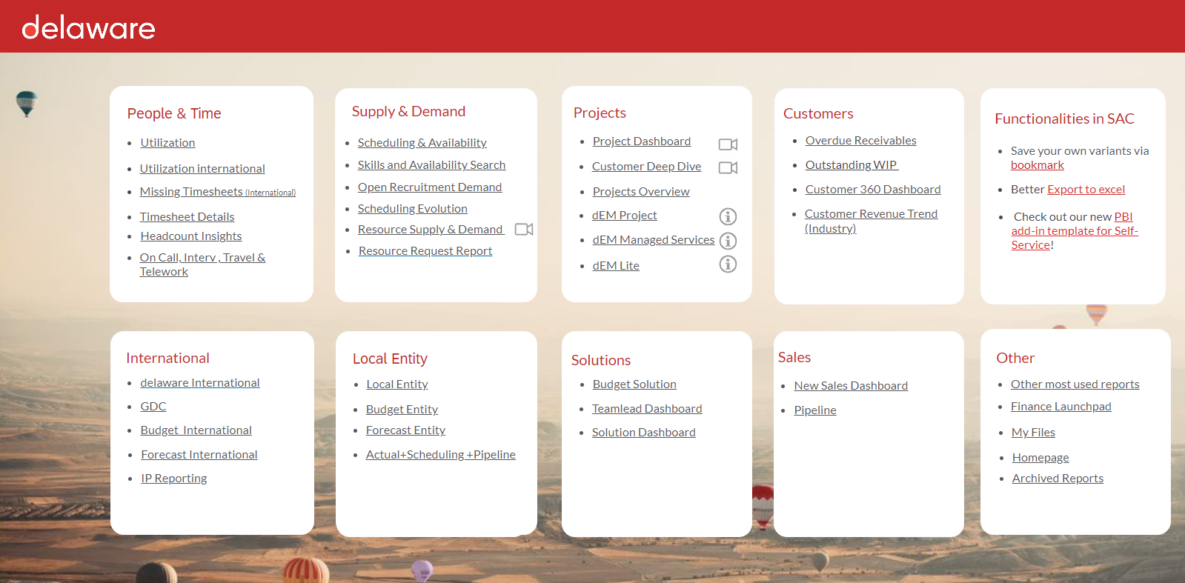
Legend:
Finance & Timesheets
Supply & Demand

Slide 68
Finance & timesheets
GDC Dashboard
GDC Utilization, P&L, employee KPI’s, Project revenue and margin,
GDC Budget
Provided in Q4 – not on SAC launchpad by default
Timesheet Details – Expected Settlements tab
Check the approved bench time bookings for your solution on at least a weekly level to avoid unnecessary settlements

Slide 69
Supply and demand
Teamlead dashboard
Scheduling and availability dashboard
Skills and availability
Actuals vs. scheduled (vs. budget) on a weekly/monthly and resource/cc/pc level
Actuals vs. scheduled (vs. budget) on a weekly/ monthly and project level
Time spent KPI’s
Missing timesheets
focus on scheduling and availabilities in a tabular way
GDC Engagement tab
GDC Adoption ratios
Act vs. sched on project company/project/employee/solution…
Availability overview including skill selection criteria (based on skillsbase assessment)

Slide 70
Supply and demand
Supply & Demand
Resource Request Overview
Recruitment dashboard
Long-term planning view including the adopted pipe
See the pipe and util of our selling entities per e.g. global pft center
See all RRF’s that still require your attention
See all open recruitment positions based on the Devops Recruitment tool.

Slide 71
Useful Ionbiz reports
Overview per project
Report on the planned amount of days on a project (for a team)
Overview per resource
Report on the planned amount of days on team level
Planning list
The ‘flattest’ report in Ionbiz. The report which includes the most filter and column possibilities.
History
The history log overview. A way to see who deleted an entry in case of doubt.

Slide 72
How to follow up on your supply & demand
2 main tools
Ionbiz: Follow up and manage your (dedicated) scheduling
SAC
Scheduling
Availability & Scheduling – availability and scheduling overviews
Timesheet details – follow up on approved bench bookings and settlement
Supply & Demand – global transparency in the selling entity’s pipe
Open RRF requests
Open recruitment – report on open GDC recruitment positions
Approved bench & Settlements
Supply & Demand
RRF
Recruitment

Slide 73
Scheduling
How do I follow up on GDC scheduling?

Slide 74
Scheduling: follow up & reporting
What is the Scheduled utilization of my team(s)?
GDC engagement: how to follow up scheduling of GDC resources on my projects ?
Operational follow up my DEDI scheduling ? Action needed.
All hours scheduled on projects with project type ‘Customer Projects’ (DEDI ànd S4H project codes) with status ‘approved’ or ‘in request’.
Filter scheduling on your teams : for whom you take responsibility of their utilization
resources not yet scheduled on a real customer project = higher risk of actuals < scheduling → approved bench time.
Local schedulers should pro-actively follow up the DEDI for next month and challenge the solution lead/ PM’s/ …..
Filter in IonBiz on the DEDI code
!For AMS we will not always adjust DEDI scheduling to real project codes (in case of multiple customer assignments). That’s ok
Scheduling on my projects, not “my” GDC resources.
Scheduling = request to work for you. If actuals < scheduled → approved bench time?
Filter on your projects

Slide 75
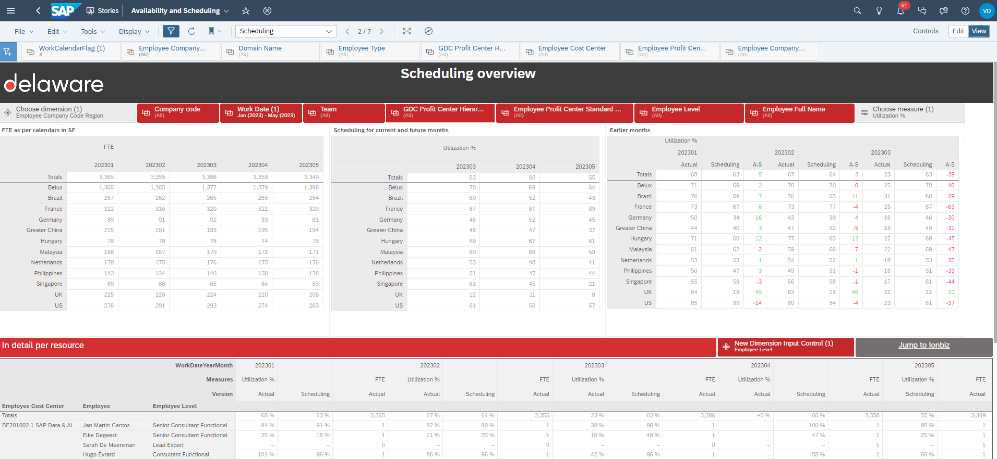
Q: What’s the scheduling of my team (s) ?
Availability & Scheduling dashboard
Page 2
Basic view per country
Utilization% or days
Scheduling of future months
Actuals (vs Scheduling) of past months
Detail per person + choose details

Slide 76
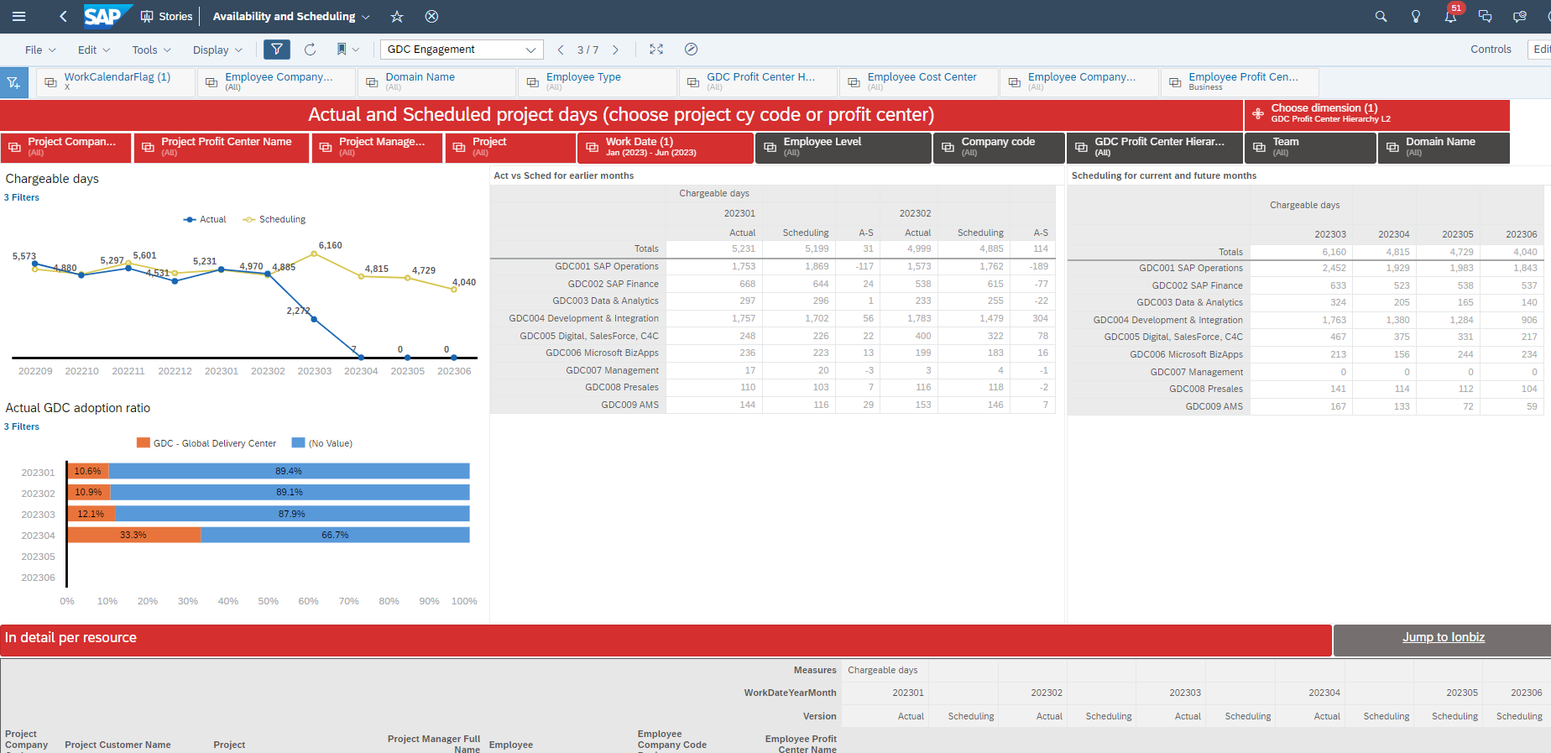
Q: How to follow up scheduling of GDC resources on my projects ?
Availability & Scheduling dashboard
Page 3
Prefiltered on GDC solutions
Filters on project
Filters on resources
Act vs Sched for past months
Sched for future months
Details per project

Slide 77
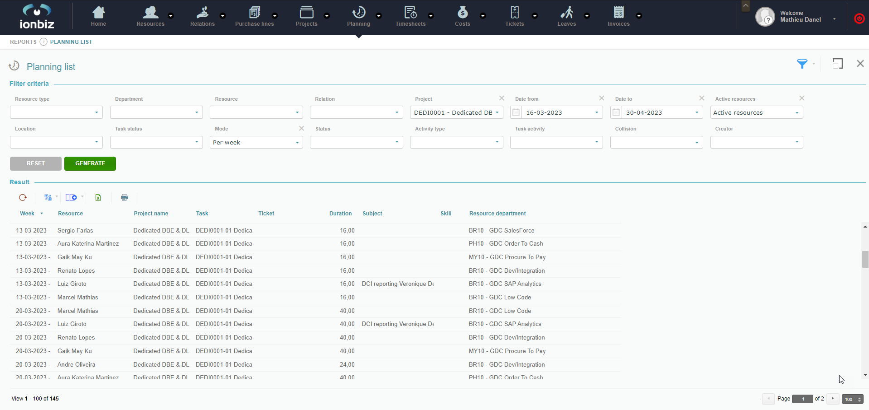
Operational follow up my DEDI scheduling ?
Planning list report
Go To IonBiz
Choose DEDI code
Request is logged to view per month
You can also filter on dpt. You might want to do that for AMS
Who’s the selling entity responsible for this dedicated scheduling?

Slide 78
Approved bench & settlements

Slide 79
Scheduling & settlement : follow up & reporting
What to expect as settlement ?
Settlement is based on timesheet registration on
“approved bench time” (shared responsibility + applies on overscheduling on DEDI ànd S4H project codes)
Training requested by ICO
Presales (on HS/CRM triggered booking codes)
Settlement per month per resource.
No settlement if resource has >80% utilization
No settlement if on 1 customer project Total Act> Total Sched
AMS settlements – Done on team and location level
First Indication if actuals < scheduling ?
(DEDI ànd S4H project codes) First follow up scheduling. Actuals vs scheduling is too late anyway. Filter on your team (GDC Mgt) or on your projects (Project Mgrs).

Slide 80
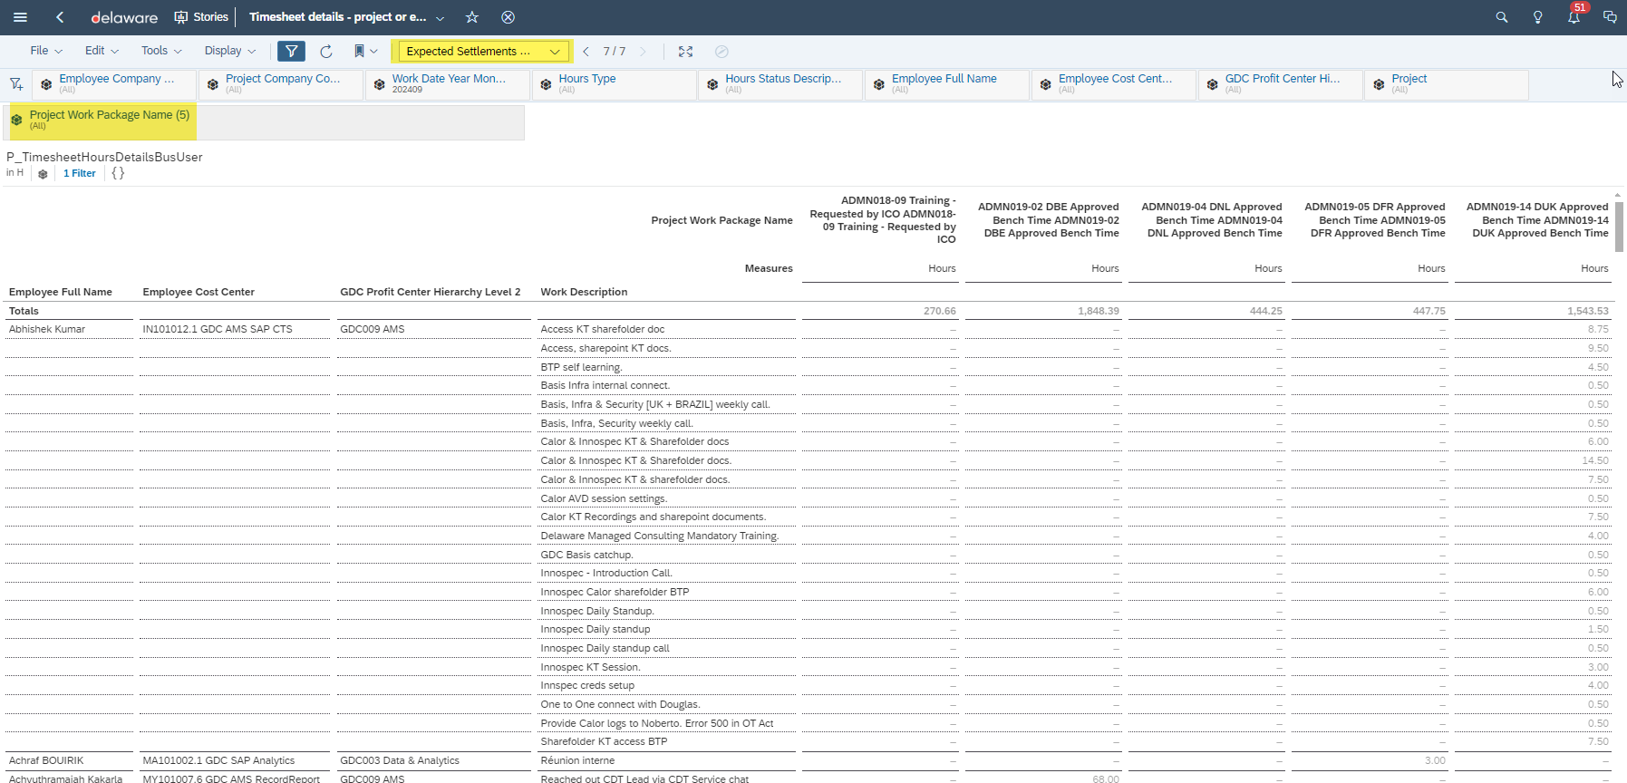
How to follow up on your settlements
SAC Timesheet Details
PROACTIVELY – SAC Timesheet details (tab: Expected settlements GDC)

Slide 81
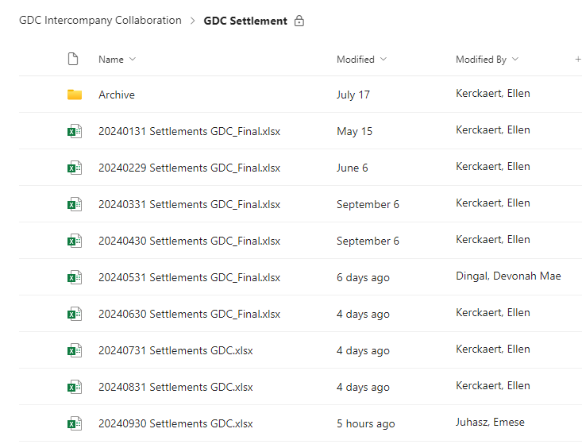
How to follow up on your settlements
Intercompany collaboration teams
RETROACTIVELY – Settlement mail Ellen Kerckaert towards Finance Responsibles

Slide 82
First indication if actuals < scheduling
SAC Scheduling & Availability
Tab: GDC Engagement
Or: Choose your project (customer or DEDI)
Or: Choose your selling entity solution
Choose your GDC solution
Or: Choose your selling entity
If actuals < Scheduling, resource might book approved bench time

Slide 83
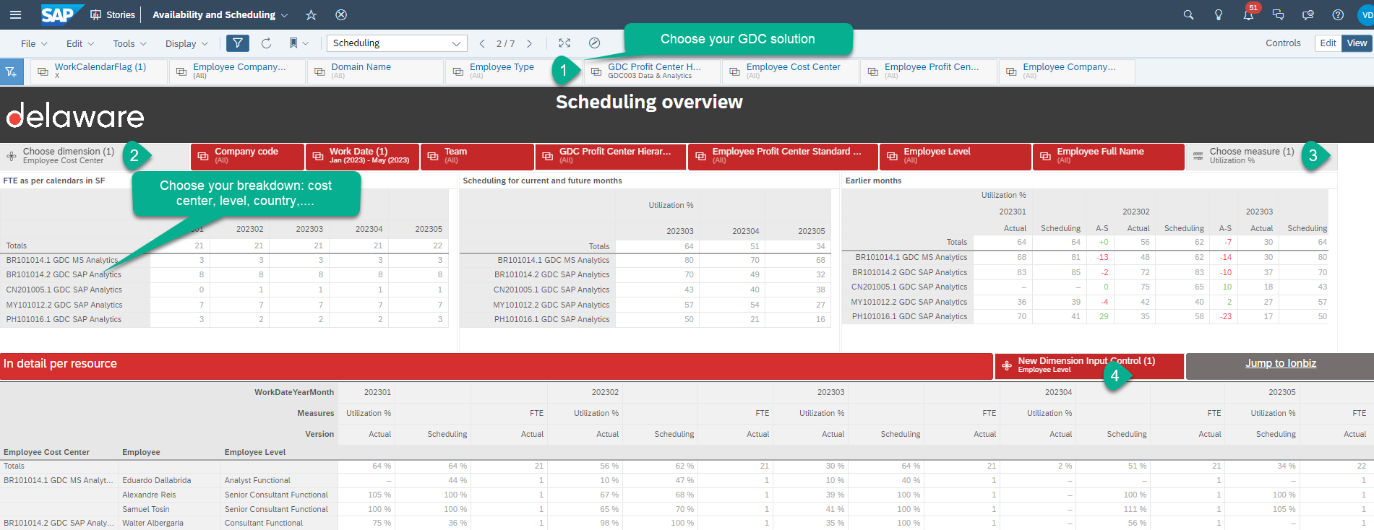
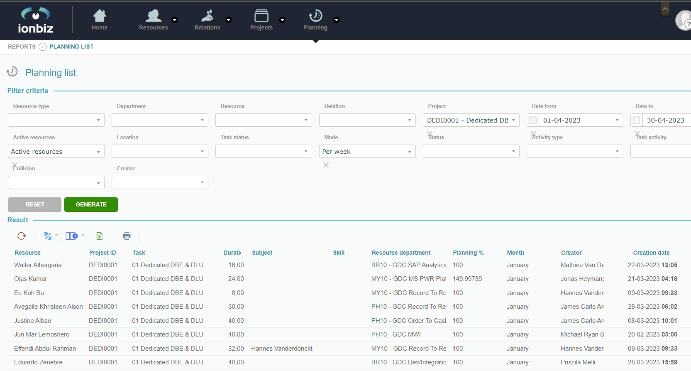
I am GDC solution Lead
SAC Scheduling & Availability
Tab: Scheduling
My team Scheduling
My GDC engagement: just look at adoption ratios per selling entity
Dedicated scheduling of my team = not scheduled on real project = high risk on approved bench time & settlement → encourage team to contact selling entity
Choose your teams
Choose all DEDI codes
Action: contact resource+subject

Slide 84
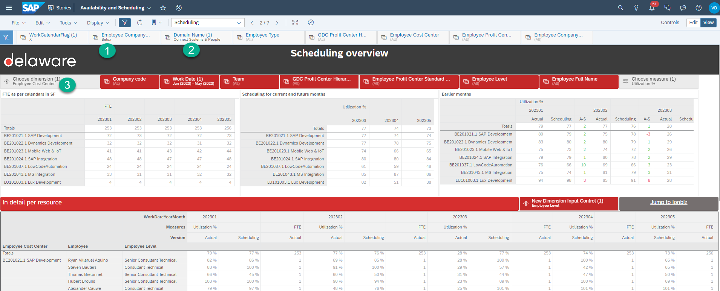
I am Belux domain lead
My (Belux) teams’s scheduling
Choose your country| DEDI code
My GDC engagement
My Dedicated scheduling = not scheduled on real project = high risk on approved bench time & settlement
First Choose your selling entity
Then choose PC’s of your domain
choose your detail
- Look at subject
- Tip: you might filter on resource dpt(“ok” per domain)

Slide 85
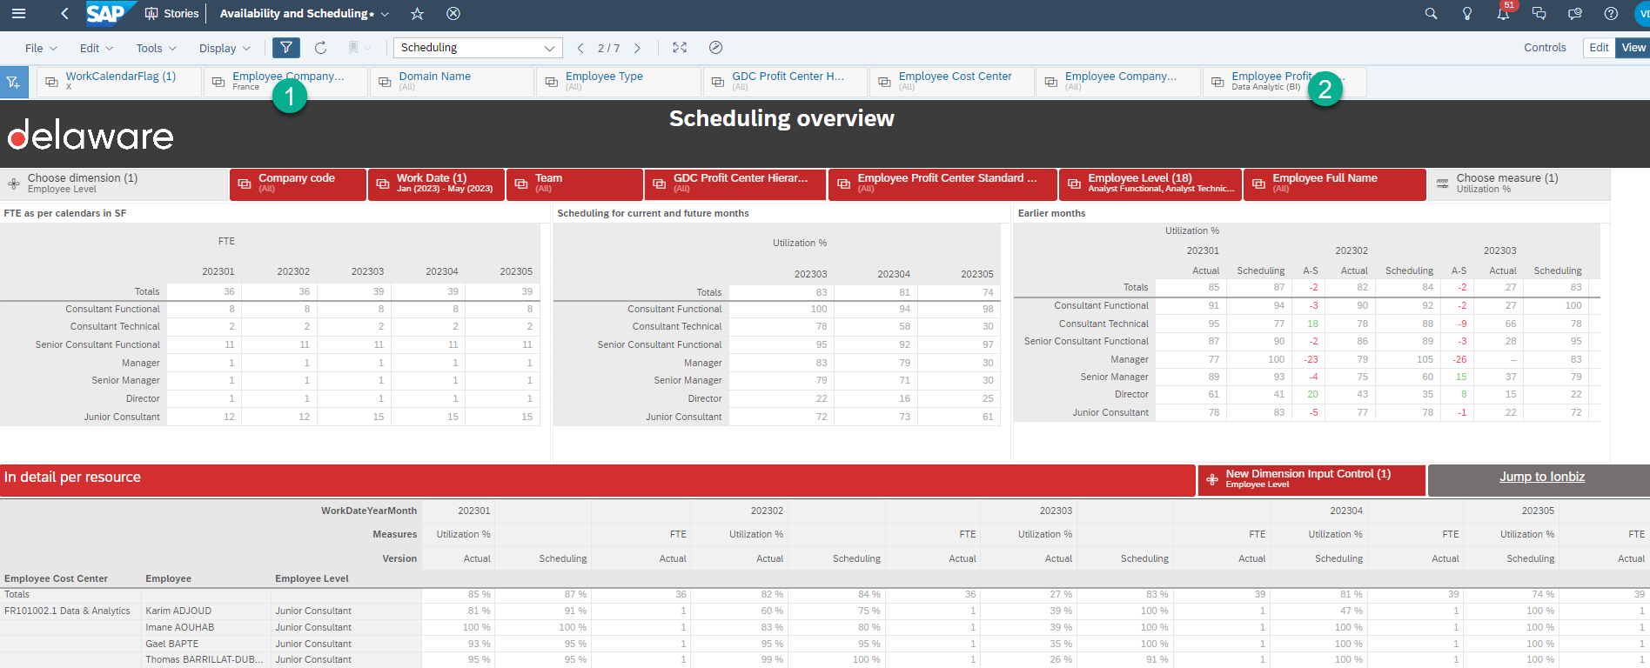
I am French solution lead
My (French) teams’s scheduling
Choose your country DEDI code
My GDC engagement
My Dedicated scheduling = not scheduled on real project = high risk on approved bench time & settlement
- Look at subject - Tip: you might filter on resource dpt(“ok” per domain)

Slide 86
I am local scheduler
Pre
Scheduled utilization of own local entity/domain
GDC engagement : follow up on DEDI codes (except AMS) : these are temporary bookings that should be replaced with real project !
Follow up on approved bench time in the course of the month = settlement coming, can we prevent more?
Post
Follow up on actuals vs scheduling: why big deviations ?

Slide 87
Supply & demand

Slide 88
The supply & demand report
Watch the S&D how-to videos here!
An extensive report combining data
Sold Work – Ionbiz planning
Unsold Work / Pipeline – CRM and Hubspot
SAC Planner functionality
GDC Adoption
Future Hires
Pipeline assumptions
…

Slide 89
RRF

Slide 90
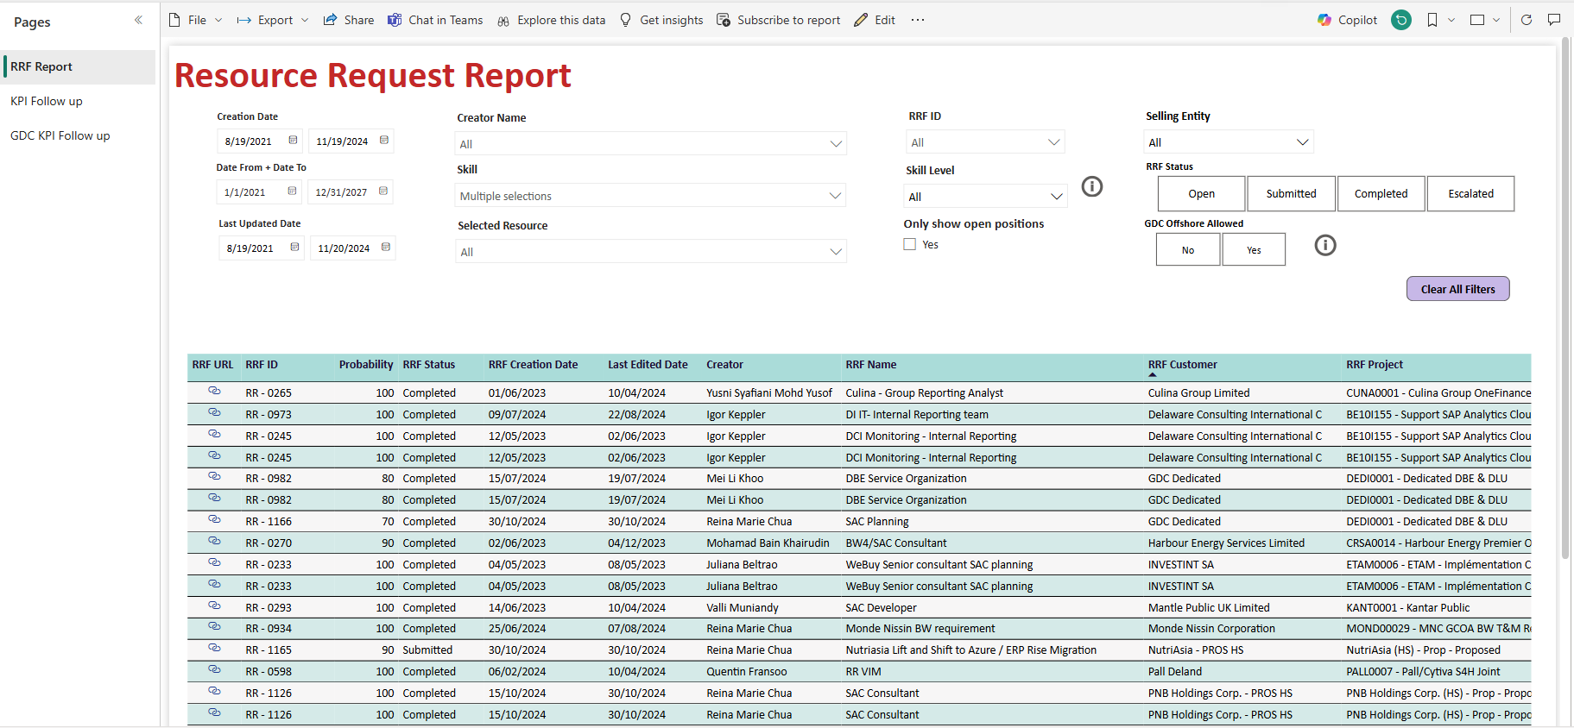
I am a requester
Filter on your name
Select if you only want to see the requests that have not been staffed
Show only the RRF’s that have been published by filtering on ‘submitted’
Clicking on the link will redirect you to the RRF in Ionbiz if you want to make changes
By hoovering over the line, you’ll see the details of your request

Slide 91
I am a GDC lead
Filter on your GDC solution(s) via the skill filter
Select if you only want to see the requests that have not been staffed
Show only the RRF’s that have been published by filtering on ‘submitted’
Clicking on the link will redirect you to the RRF in Ionbiz if you want to make changes
By hoovering over the line, you’ll see the details of your request

Slide 92
Recruitment

Slide 93
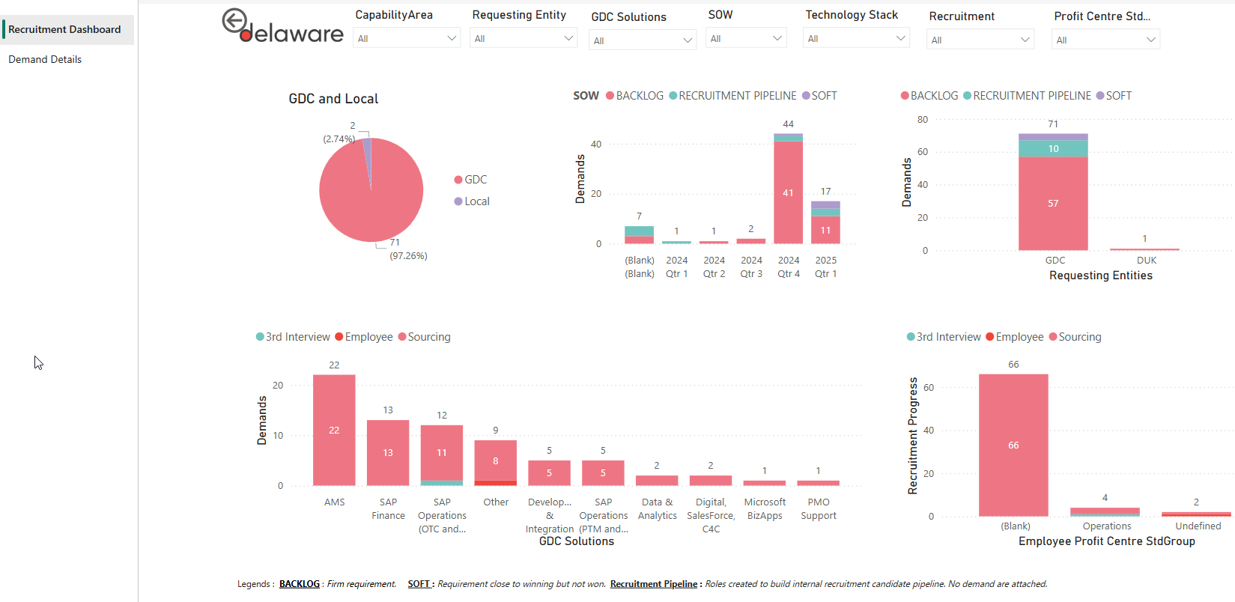
I am GDC management
PBI Recruitment Overview
This tab will show you the key takeaways

Slide 94
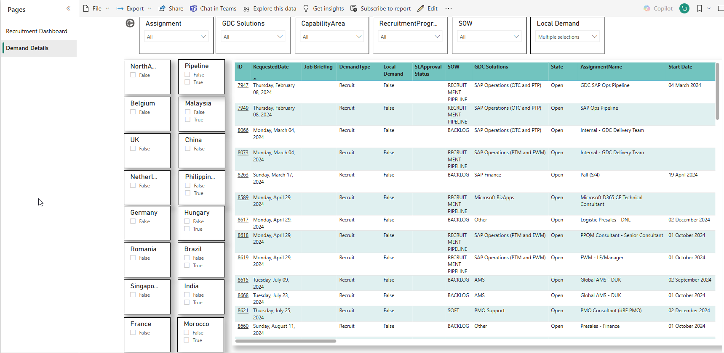
I am a GDC lead
PBI Recruitment Overview
You can filter on your solution
This tab will show you the key takeaways
Scroll to the right to see the details per open recruitment
Click on the ID to open the devops recruitment request and adapt it

