Slide 3
welcome to a new era financial planning
& analysis
presenter name / 09.2023
Notes:
2024 © delaware (general)
2024 © delaware - For internal use only (for training and guidelines)
2024 © delaware - Confidential (for commercial proposals to customers)

Slide 4


agenda
financial planning & analysis
business transformation journey
delaware solutions

Slide 5
financial planning & analysis
Let us drive your organization towards financial business innovation

Slide 6

Most executives will tell you that when shaping business plans and strategy, forecasts can serve as a great counterweight to gut feelings and biases. Most will also admit, however, that their forecasts are still notoriously inaccurate.
Mckinsey Aug 2020

Slide 7


trends & facts
A planning process well structured and integrated may helps results up to 50% in incremental margin over the years.
McKinsey,
2022
76% of CFOs believe at least half their time should be spent on
high-value planning and analytics activities, vs 55% who
actually do this.
SAP,
2015
Finance organizations have, on average, decreased their cost by 29%.
McKinsey,
2020
Increase results
High-value time
Cost improvements
It’s important to have a single source of truth, which means all business areas tell the same story.
Monthly reporting process reduced from two days to about 30 seconds.
Harvard Business Review,
2022
Finance teams will need efficient ways to generate and disseminate real-time forecasts that reflect rapidly changing circumstances.
McKinsey
Aug 2020
Top-performing finance functions devote 75% of their time to data analysis and insights.
Harvard Business Review,
2022
Source of truth
Report automation
Predictive analysis
Better insights

Slide 8
challenges
Agility
Management reporting is mostly manually prepared and can be delivered only around period-end, lacking timeliness, efficiency and precision
Data confidence
Profitability and performance analysis is conducted
with inflexibility and limited data confidence,
resulting in inefficient decision-making.
Better decisions
Difficult to transform business data into critical insights due to suboptimal data quality and limited data visualisation capabilities.
Data collection
Manual effort and collaboration with other departments are needed to access financial data, making it difficult to get a true picture of business-wide financials in real-time.
Notes:
Inaccurate or Incomplete Data: One of the biggest challenges faced by organizations is the quality and completeness of financial data. Often, data is scattered across different systems and departments, making it difficult to get a complete picture of financial performance.
Time-Consuming Process: The FP&A process can be very time-consuming, requiring significant resources and expertise to complete. This can be a challenge for organizations with limited resources or where the finance team is already stretched thin.
Limited Resources: Many organizations have limited resources for their FP&A function, which can make it difficult to complete the necessary analysis and reporting in a timely manner.
Lack of Visibility: Another challenge faced by organizations is a lack of visibility into future performance. This can make it difficult to develop accurate forecasts and make informed decisions.
Changing Business Environment: The business environment is constantly changing, which can make it difficult to keep up with new trends and adjust forecasts accordingly. This can lead to inaccurate or outdated forecasts, which can have negative impacts on the organization.

Slide 9


about delaware
  We are a global company that delivers advanced ICT solutions and services, guiding our customers through their business and digital transformations.
  We develop, innovate and implement international business consulting, effective strategies and change management solutions.
  Above all, we want to do the right thing. We deliver enterprise expertise that enables our customers’ businesses to reach their full potential, while creating
  a positive impact in a challenging world.
Watch our international story
  We make it happen. You can rely on us.
Notes:
Link to company movie (behind red circle) https://youtu.be/GBg_RLvomE0
Paragraph 1: We provide them with the insights, advice and tools to achieve their mission-critical priorities.
Paragraph 2: In addition to our partnerships with SAP, Microsoft, Salesforce and OpenText, we rely on a select group of technology partners to support our customers in creating a truly omnichannel customer experience.
Paragraph 3: We take responsibility for our relationship with the social and ecological environment .

Slide 10
delaware today
  The Netherlands (Den Bosch, Naarden, Eindhoven)
  Belgium (Antwerp, Ghent, Kortrijk, Wavre, Lummen, Liège)
  Luxembourg (Belval)
  France (La Madeleine, Lyon, Nantes, Paris, Bordeaux)
  Germany (Zweibrücken, Köln, Hamburg)
  Romania (Cluj)
  +4600 professionals
  37 offices in 19 countries
  €490 mio revenue
  USA
  (Dallas)
  UK (Bristol)
  Ireland
  Hungary
  (Budapest, Debrecen)
  Canada
  (Vancouver)
  Morocco
  (Casablanca)
  India
  (Noida)
  China
  (Harbin, Hong Kong
  Shanghai, Suzhou, Chengdu)
  Puerto Rico (San Juan)
  Brazil
  (São Paulo)
  Singapore (Singapore)
  Malaysia (Kuala Lumpur)
  The Philippines (Taguig)

Slide 11
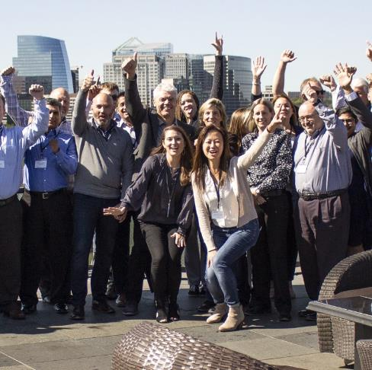

our purpose
  We are a partnership of stewards,
  realizing a dream for today, tomorrow and succeeding generations.
We enable our people, our company and our customers to reach their full potential combining our skills, our values and best-in-class technology.
We want to positively impact the world we live in.

Slide 12

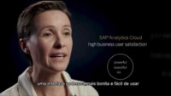
delaware runs SAP
In 2015 delaware led SAP's digital innovation initiative, being the first company globally to implement S/4HANA Cloud and since then we have been using SAP's entire cloud platform in-house.
As SAP users, we know exactly what are the business goals and how we daily deal with it.
Our business knowledge combined with the experience of being SAP users and suppliers takes delaware to another level.

Slide 13

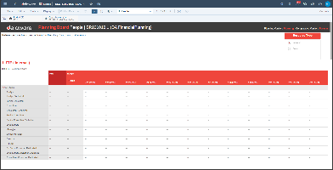
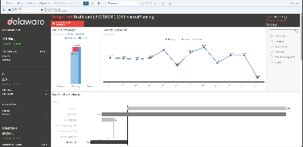
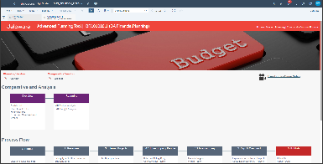
our success cases
– ourselves
  Standardized planning flow that allows the progress of each activity to be monitored;
  Systemic integration, allowing information to be monitored in real time
  Collaborative process, where each entity contributes in a standardized way
  Consolidate several entities automatically and in real time
  Scenario simulations in just one click
  Single source of truth
  Information security, change control and access controls
  Uses predictive analysis algorithms to automatically generate future trends

Slide 14


our success cases
Challenge
  Make planning process collaborative
  Simplify budget process to be more effective
  Easy and quick simulation
Industry
oil and gas, electrical energy
Scope
  end-to-end implementation: revenues, expenses, human resources (Payroll), investments, statements (P&L and Cash Flow)
Depoiments
  Entire process from months to days
  We are able to forecasting and simulations quickly
  Consolidating information is no longer a concern, the system takes care of it automatically
  Today we save time and costs, we are more efficient

Slide 15


our success cases
Challenge
  Make planning process collaborative
  Simplify budget process to be more effective
  Easy and quick simulation
Industry
Mining
Scope
  end-to-end implementation: revenues, expenses, human resources (Payroll), investments, statements (P&L and Cash Flow)
Depoiments
  Entire process from months to days
  We are able to forecasting and simulations quickly
  Consolidating information is no longer a concern, the system takes care of it automatically
  Today we save time and costs, we are more efficient

Slide 16


our success cases
Challenge
  Make planning process collaborative
  Simplify budget process to be more effective
  Easy and quick simulation
Industry
Retail
Scope
  end-to-end implementation: revenues, expenses, human resources (Payroll), investments, statements (P&L and Cash Flow)
Depoiments
  Entire process from months to days
  We are able to forecasting and simulations quickly
  Consolidating information is no longer a concern, the system takes care of it automatically
  Today we save time and costs, we are more efficient

Slide 17


our success cases
Challenge
  Make planning process collaborative
  Simplify budget process to be more effective
  Easy and quick simulation
Industry
Agribusiness (bioethanol, sugar, renewable energies)
Scope
  end-to-end implementation covering revenues, expenses, agricultural and industrial costs, stocks, human resources (Payroll), investments, statements (P&L, Cash Flow, balance sheet)
  attending to stakeholders and official reports
Depoiments
  Entire process from months to days
  We are able to forecasting and simulations quickly
  Consolidating information is no longer a concern, the system takes care of it automatically
  Today we save time and costs, we are more efficient

Slide 18

our success cases
Challenge
  Make planning process collaborative
  Simplify budget process to be more effective
  Easy and quick simulation
Industry
Car rental
Scope
  end-to-end implementation covering revenues, expenses, human resources (Payroll), investments, statements (P&L, Cash Flow, balance sheet)
  attending to stakeholders and official reports
Depoiments
  Entire process from months to days
  We are able to forecasting and simulations quickly
  Consolidating information is no longer a concern, the system takes care of it automatically
  Today we save time and costs, we are more efficient

Slide 19
FP&A digital transformation journey
transform your manual processes into a secure, integrated, and digital one through effective financial planning

Slide 20
the journey
2
define your strategy
1
advisory
define a strategy that is aligned with all stakeholders can help ensure that everyone is working towards the same goals and objectives.
expert teams can help businesses stay ahead by using best practices and technology to simplify processes, streamline workflows, and improve performance for sustainable growth.
4
creating value
3
culture change
Leverage insights to inform business decisions and drive success.
Make informed decisions with data-driven insights.
Quickly simulate scenarios to test various outcomes and inform decision-making.
Use predictive scenarios to preview and plan for the future.
Increase agility by simplifying workflows.
Automate rules and integrations for efficiency.
Focus on analysis and insights for better decision-making.

Slide 21
benefits
improve accuracy of financial planning, budgeting and forecasts
25% - 50% reduction in budgeting and forecasting costs
*50% + reduction in cycle time for financial forecasting and reporting
*50% + reduction in financial forecasting error rate
(*based on SAP benchmarking)
a single source of truth
Make predictions on your financials with flexibility, intelligence, and confidence.
Compare actual and plan values without any manual effort of data consolidation
Make confident predictions on financials based on integrated and accurate data
agile and integrated process
make forecasts on financials
Get a visualised summary of the company performance with Google-like search;
monitor the key financial KPIs across the company in real time using a customisable dashboard;
An integrated planning tool that provides actionable insights, metrics visualisation and what-if simulation
make better decisions based on embedded "smart insights“.
real time analysis
better decisions
Notes:
NEEDS
Ability to conduct profitability and performance analysis at any level of granularity or business dimensions with flexibility, transparency and accuracy
Obtain a single source of financial truth, which facilitates insights to actions
Capability to access financial data in real time, eliminating information latencies that can dull competitive edge
Ability to deliver up-to-date management reporting with ready-to-use data visualisation and minimal preparation effort
Visibility into different dimensions of planning and profitability across the entire enterprise
Leverage financial analytics and financial reporting to obtain valuable insights and make confident decisions
Obtain automated data visualisation and use the results for forecasting, planning and conducting what-if analysis
JOURNEY SUMMARY AND TAKEAWAYS
Be able to help Best Run secure continuous financial success thanks to
Efficient profit and cost analysis at any granularity level and business dimensions
Real-time overview of corporate performance and profitability with embedded smart insights
Automated forecasts and predictive analytics that are easy to use, time-saving and accurate
An integrated planning tool that provides actionable insights, metrics visualisation and what-if simulation

Slide 22
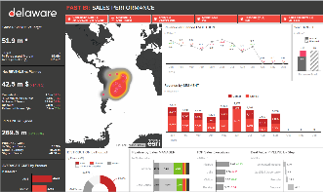
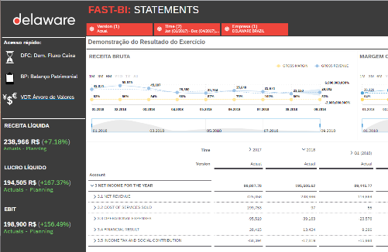
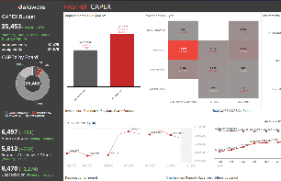

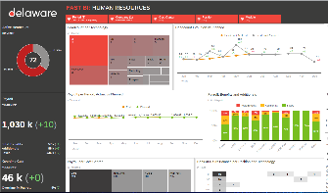
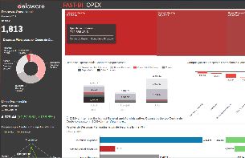
our solutions

Slide 23


why delaware?
  the best finance business experts;
  a global FP&A competence center;
  FP&A solutions packages;
  SAP Platinum Partner;
  Niche Player in the Gartner Magic Quadrant Worldwide;
  50+ SAP Analytics Cloud success implementations;
  We improve our business as SAP worldwide customer, including FP&A

Slide 24
delaware store
check out delaware’s FP&A solutions and products

Slide 25


delaware store
  visit the delaware store and check out our FP&A solutions and products
add link to delaware store

Slide 27
thank you for your time
Tayna Veiga
Tayna.Veiga@delaware.pro

