Slide 2
experiment name: “xxxxxxxxxxxxxxxxx”
Logo
Context
Research question
Innovation challenge
Deliverable
….
…
…
…
Goal
Scope
Approach
Resources customer
…
…
…
Business owner : xxx
Project owner : xxx
Resources : xxx

Slide 3
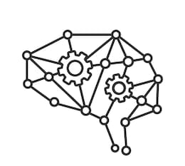
experiment name: “Machine Learning notifies operators for ‘difficult’ production orders”
Context
Research question
Innovation challenge
Deliverable
All our production orders are customized products with many variables. Some products are easy to make, others are difficult. And there can be many reasons for this. Difficult products require higher attention of the operators to avoid production waste. How can we attract the right attention of the operator to the right production order/production line ?
Based on historical production data, we did a small test with MS Azure Machine Learning Studio to estimate ‘the risk’ of a production order, and results are promising.
Can we integrate MS Azure Machine Learning Studio in an SAP ERP driven shopfloor in nearly real time? Every planning cycle, the risk score of every production order should be calculated and made visible for the operators.
How can Machine Learning improve the algorithms continuously without traditional intervention of analysts and developers?
Use of the non-coding Machine Learning Studio by business responsibles, not IT analysts and developers
Integration of SAP ERP and MS Azure ML Studio in a nearly real-time production environment
At the end, we want a working process flow where SAP provides the Azure ML Web service with new production data. Where the data is being processed and the prediction is being used in the required SAP process.
The real result, plus the predicted value should be added to the ML Algorithm to retrain and improve the predictability.
Goal
Scope
Approach
Resources customer
Having a self-training Machine Learning algorithm, managed by business people, rather than IT technical people.
Integration between Azure Machine Learning Studio and SAP ERP.
SAP ERP production scheduling and shopfloor execution
Historical production data from SAP ERP and Biwarehouse
MS Azure Machine Learning Studio
Step-by-step waterfall approach.
Pilot development in Belgium
Pilot implementation in Turkey
Roll-out to all production units worldwide
Business owner: Rik Holvoet
Project owner: Jeroen Meul
Resources: Internal & Del 20

